Slide 1
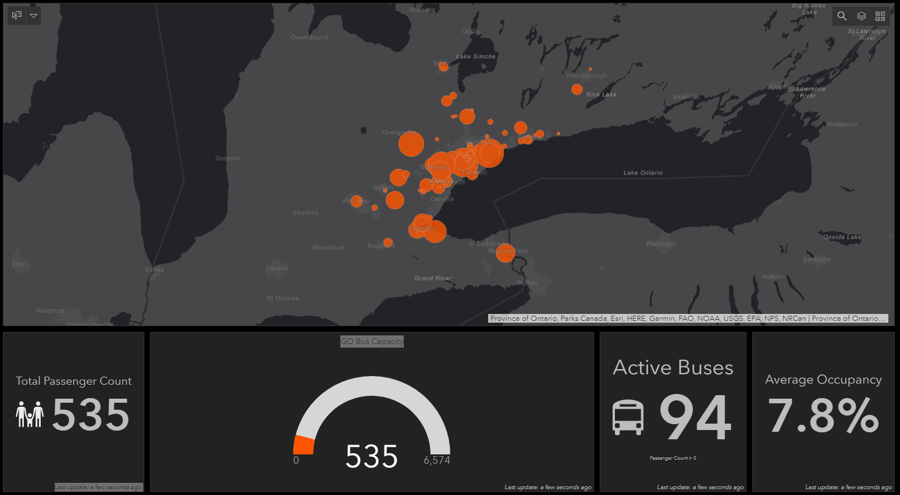
Driving GO Bus
Into The Future:
Strategic Planning & Performance
Measurement Using Big Data from PrestoBI & APC During COVID-19
Anthony Smith, Senior Planning Officer, Service Expansion, Metrolinx <anthony.smith@metrolinx.com>
Eddy Ionescu, Computer Science Student, University of Waterloo <eddyionescu@gmail.com>
TRANSIT DATA 2020: SESSION 2-A: SYSTEM AND ROUTE PERFORMANCE MONITORING APPLICATIONS

Slide 2
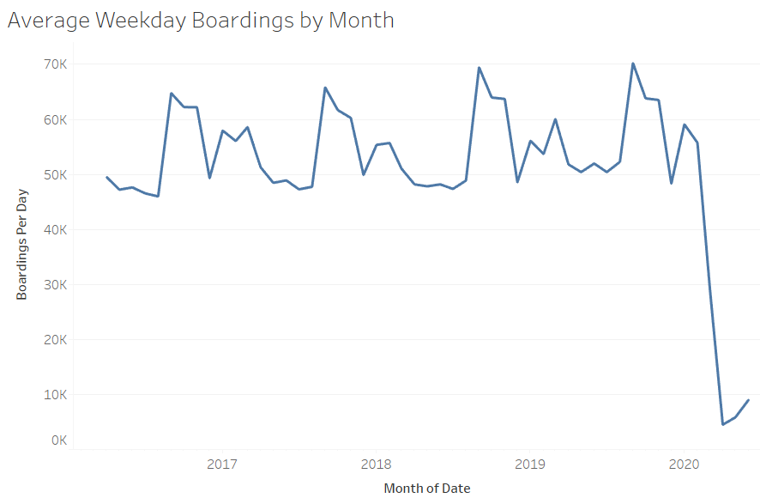

OBJECTIVE - Use Big Data to Maximize Performance During COVID-19 & Beyond
WHY - Increase ridership & revenue while ensuring safe & effective delivery of GO service
HOW - Harness the power of big data including Presto & APC on daily or real-time basis
WHAT – Develop new tools to monitor customer demand & optimize service deployment during COVID-19 & beyond
Prototype for Illustration Only – Data are not official record

Slide 3
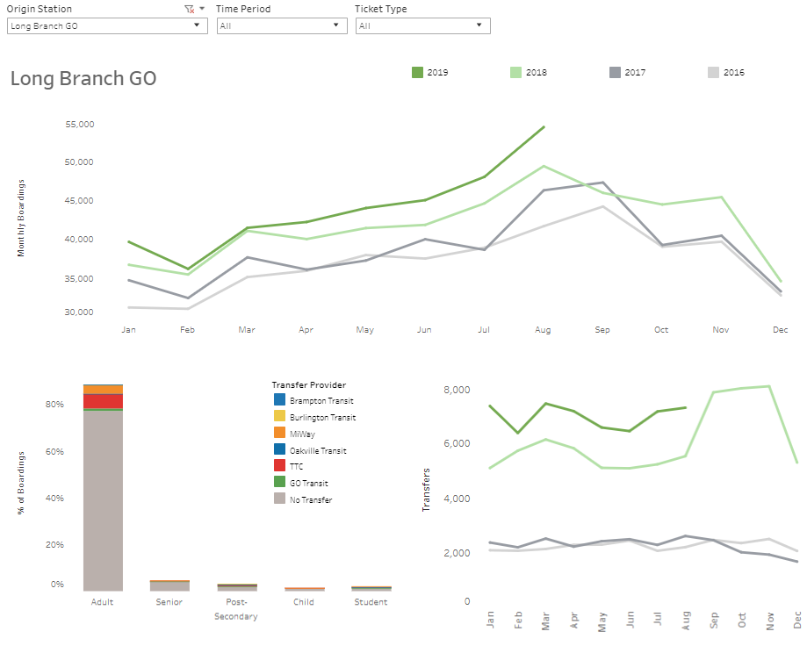
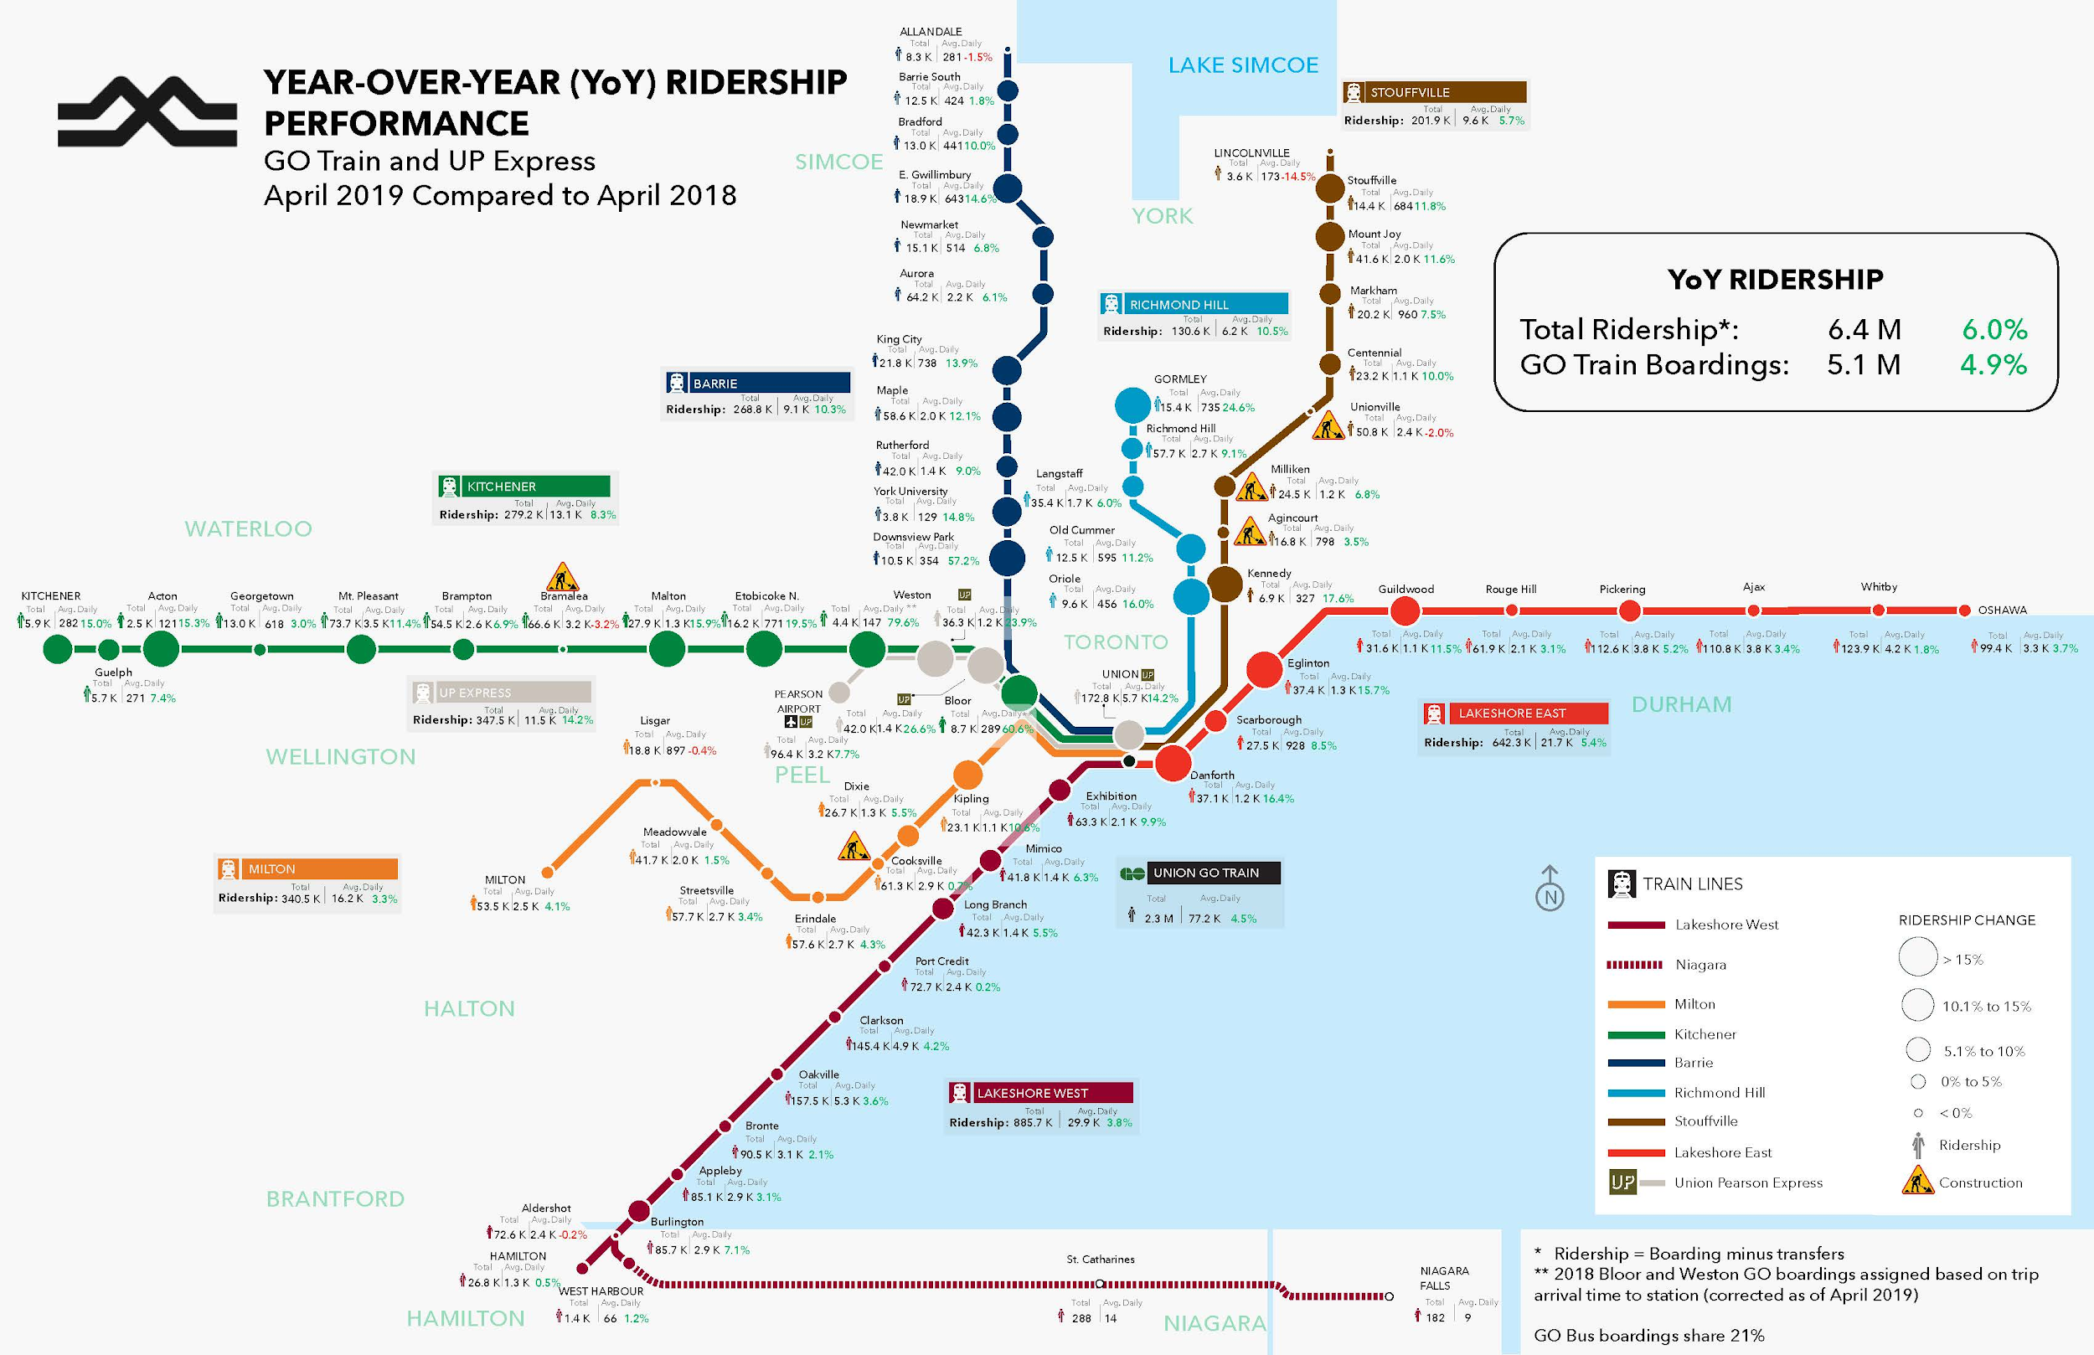
KEY FINDINGS – Monitoring Boardings using PRESTOBI
PrestoBI provides direct insight into boardings overall, and by GO Rail station or trip
Boardings are reported daily to SMT & in monthly KPI maps released as Open Data
Data can be analyzed as OD pairs, but GO Bus data are grouped by Fare Zone, so not ideal for route & stop-level insights
Prototype for Illustration Only – Data are not official record

Slide 4
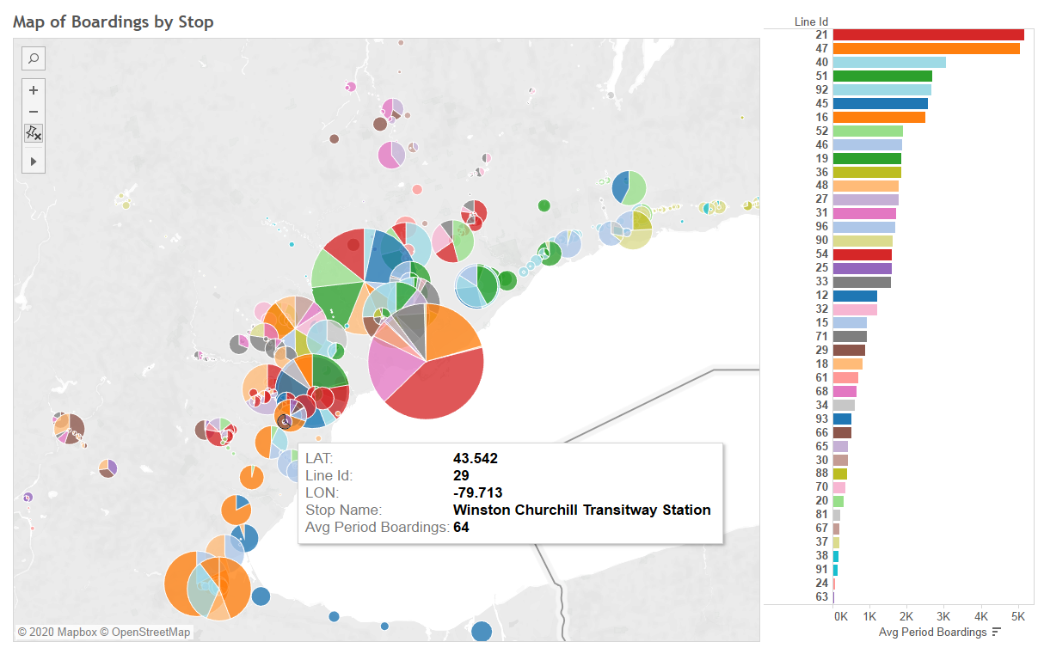
KEY FINDINGS - Monitoring Boardings using Automatic Passenger Counters (APC)
APC data are combined with service data from CAD/AVL systems on busses
Data provide a rich source of information about boardings per route, trip and stop
Currently testing display of bus capacity on DSSI screens & on a web-map using a geoevent process that consumes live APC data & writes it to an EGDB s every 20 sec.
Prototype for Illustration Only – Data are not official record
Prototype for Illustration Only – Data are not official record

Slide 5
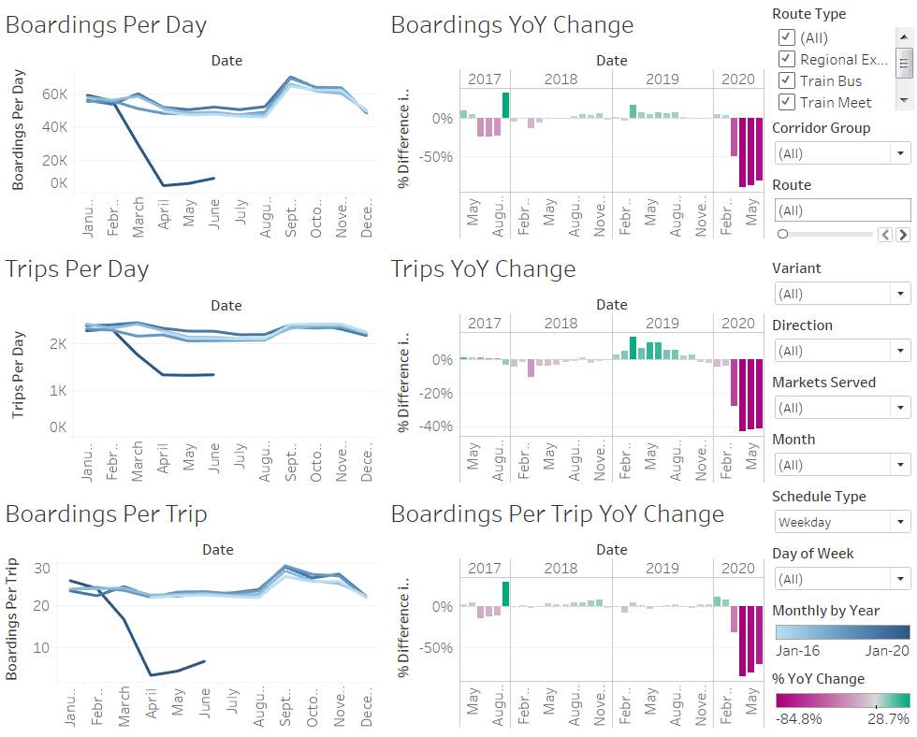
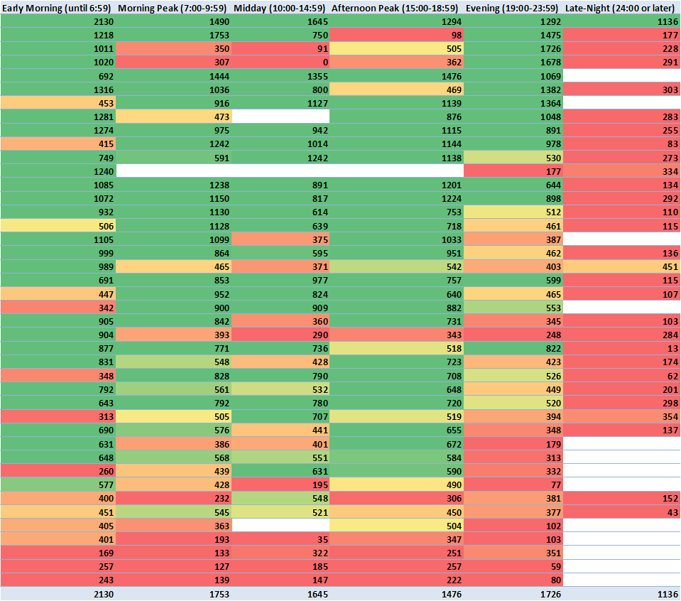
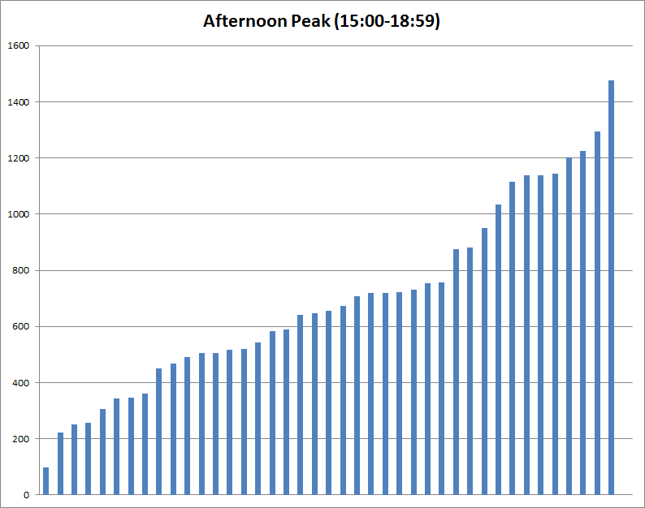
KEY FINDINGS – Measuring GO Bus Performance
As a regional operator, effectiveness is best measured based on Passenger Kilometres / Hour of Revenue Service
SQL database queries are used to extract PKH by route, direction, branch, and service-period
Extracted data are loaded into an Excel PivotTable and Tableau for analysis and visualization
Prototype for Illustration Only – Data are not official record

Slide 6
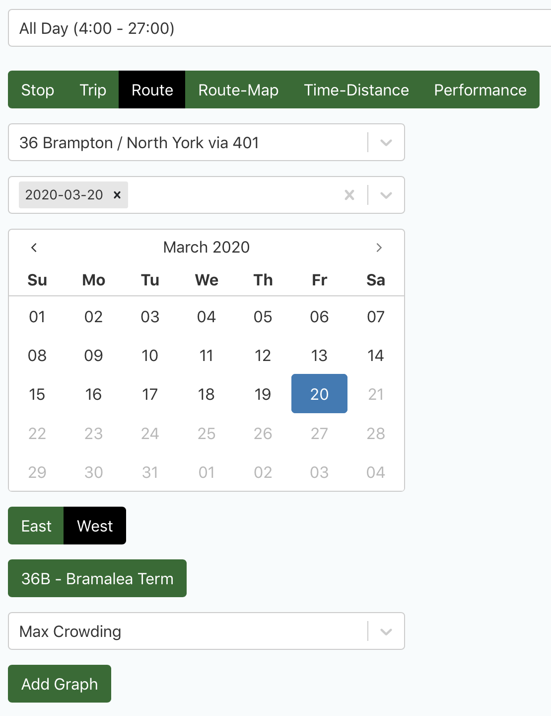
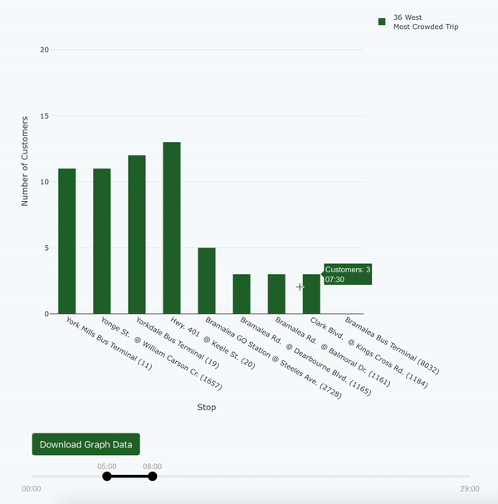
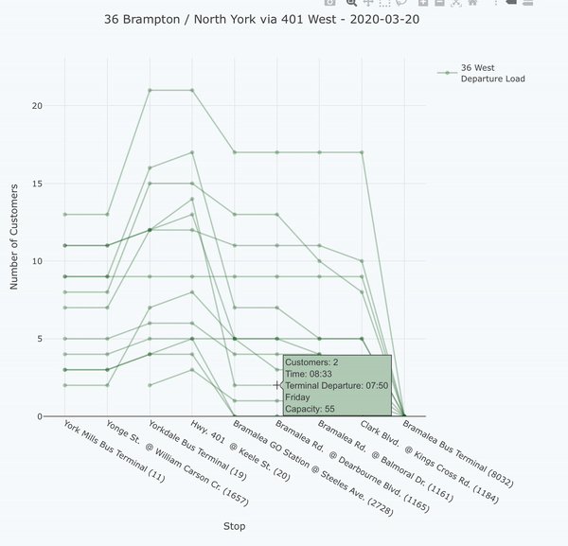
TRANSIFY APPLICATION - Enhanced Analysis of Trip-level Crowding & Performance
Dashboard goes past KPIs to help understand individual route & trip patterns
Quickly identifies which route segments and time periods experienced overcrowding (e.g. trips with over 15 customers in a 55-seat GO bus)
Prototype for Illustration Only – Data are not official record

Slide 7
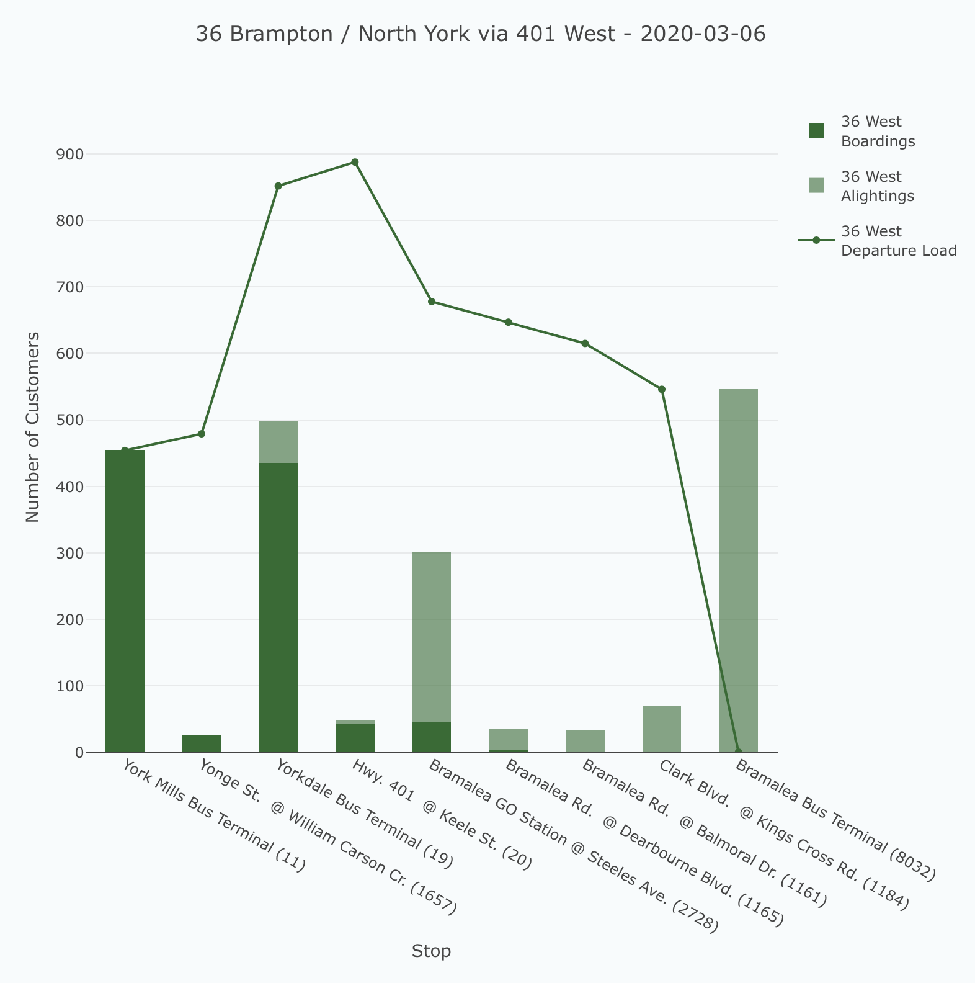
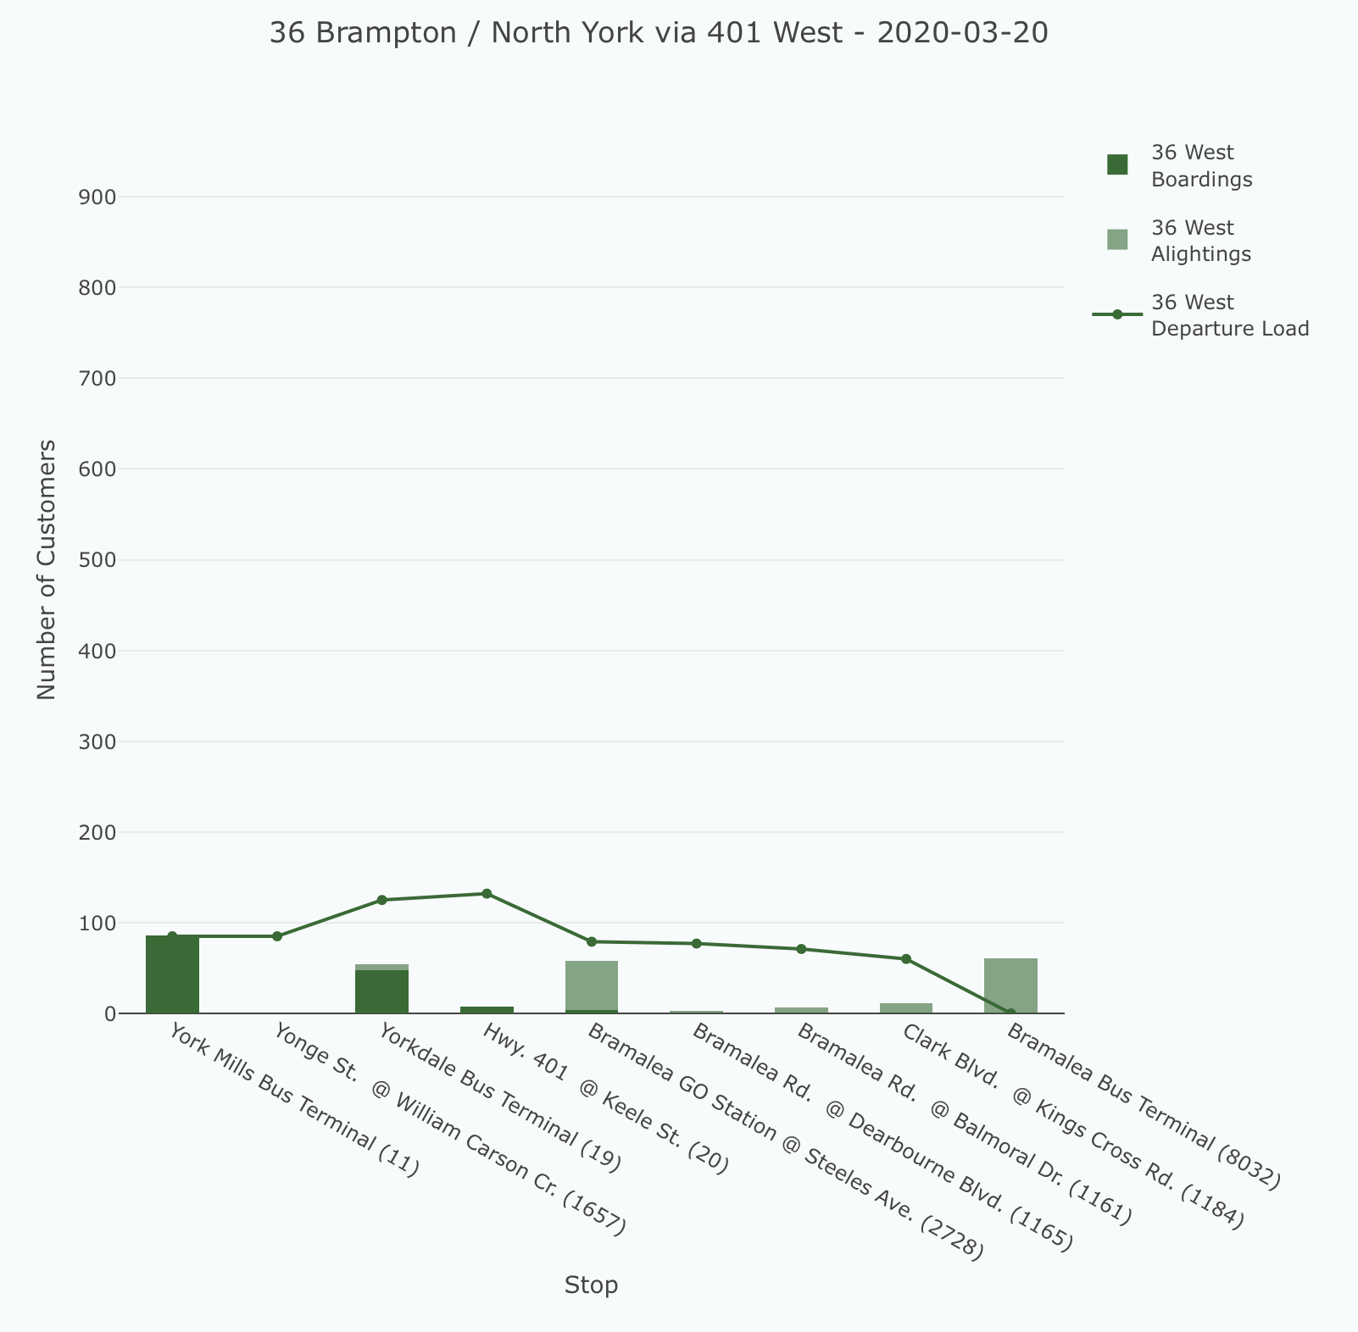
TRANSIFY APPLICATION - Enhanced Analysis of Route Usage & Performance
Can also identify trip purposes by linking ridership patterns, times & trip-generators
Route ridership patterns changed at the start of the pandemic, observed differences between office, retail, post-secondary, & airport destinations
Prototype for Illustration Only – Data are not official record

Slide 8
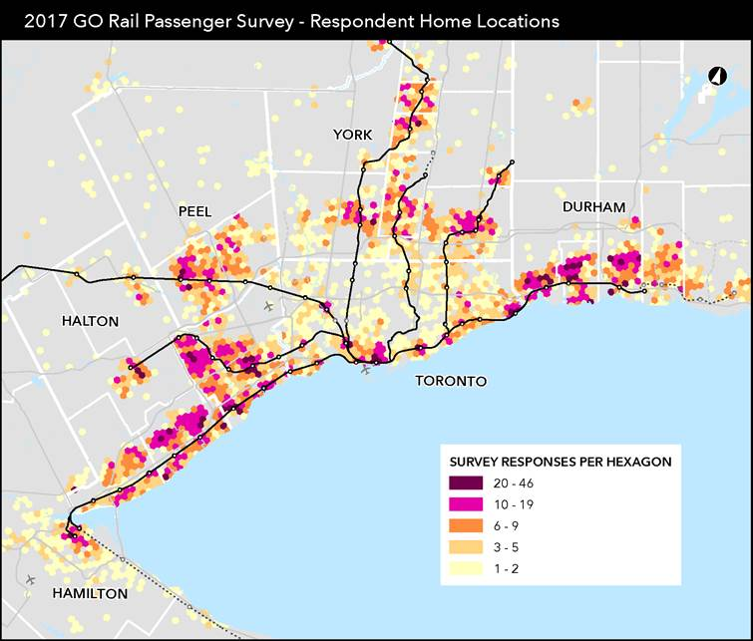
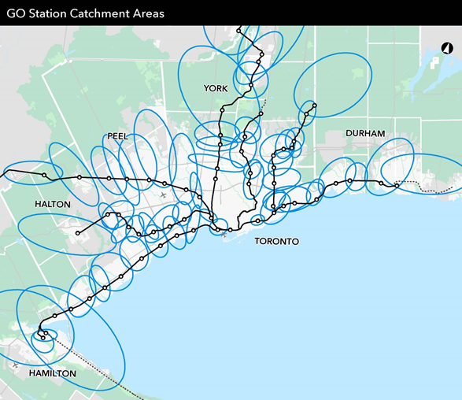
LESSONS LEARNED & FUTURE DIRECTIONS
Focus on customer experience from a user journey point of view, such as station access, dwell times & reliability
KPIs should measure desired outcome, e.g. use of Service Hours over KMs
There are always insights to be found by diving deep into data
Use surveys to supplement data
Emerging opportunity to view crowding & OD data based on cellular, GPS & Wi-Fi data
Prototype for Illustration Only – Data are not official record

Slide 9
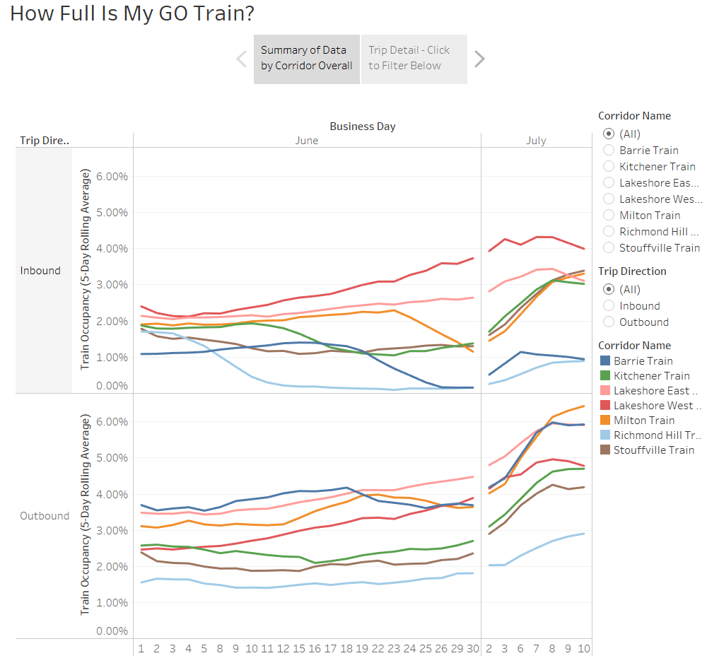
CONCLUSIONS
Presto & APC are key datasets to improve customer safety & grow ridership & revenue
Trend data help to align service deployment with dynamic customer demand
Rigorous KPIs like Passenger Kilometres / Revenue Service Hour, subset by route type, can identify routes for optimization
Data are also used to support strategic initiatives including the 10-Year GO Bus Strategy & Regional Fare Integration & Business Cases for new transit infrastructure
Prototype for Illustration Only – Data are not official record

Slide 11
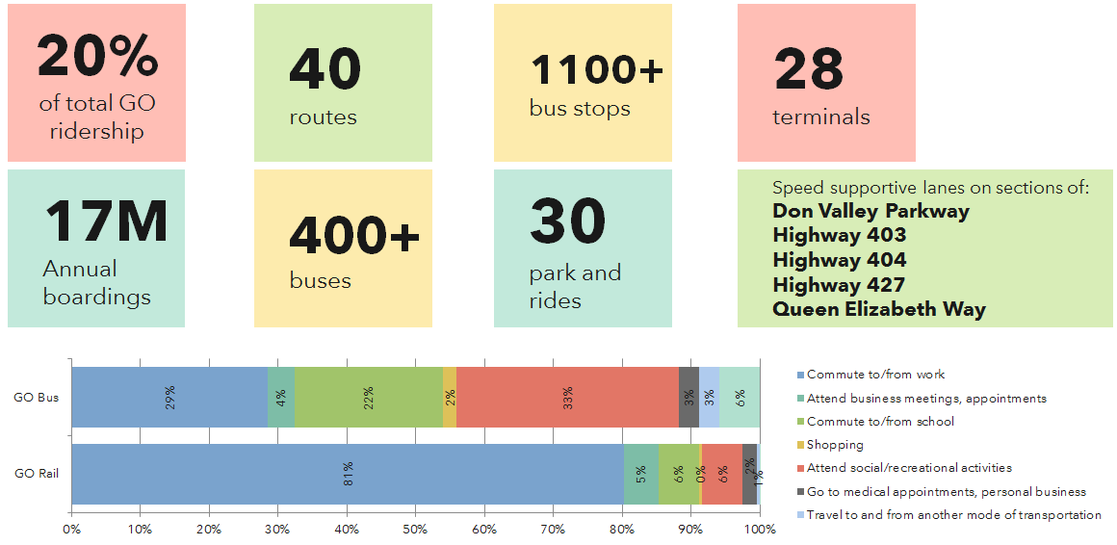
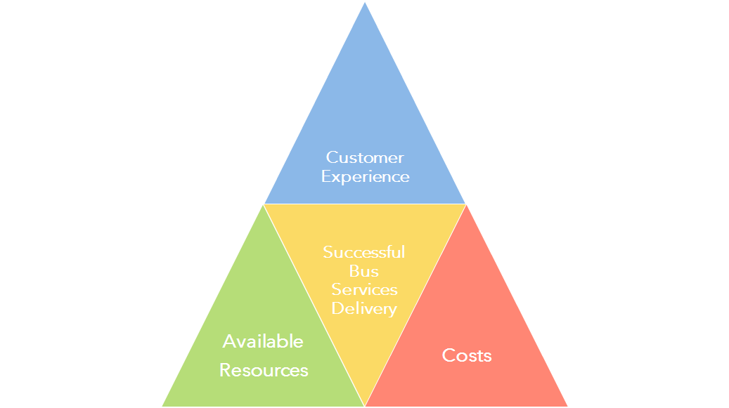
GO BUS SERVICE DEVELOPMENT CONTEXT

Slide 12
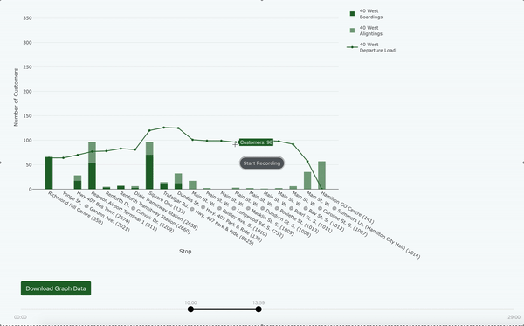
TRANSIFY APPLICATION - Enhanced analysis of route usage and performance
Identified how ridership in each route segment changes based on different sources of demand (office, retail, and airport travel)
Informs potential service changes such as express branches
Prototype for Illustration Only – Data are not official record

Slide 13
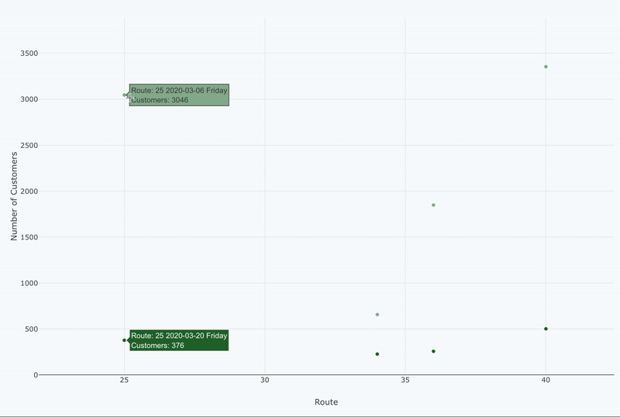
TRANSIFY APPLICATION - Enhanced analysis of route usage and performance
Identified trip purposes by linking ridership patterns and trip-generators
Route ridership patterns changed at the start of the pandemic
Drop in demand varied for office, retail, post-secondary, and airport destinations
Prototype for Illustration Only – Data are not official record

Slide 14
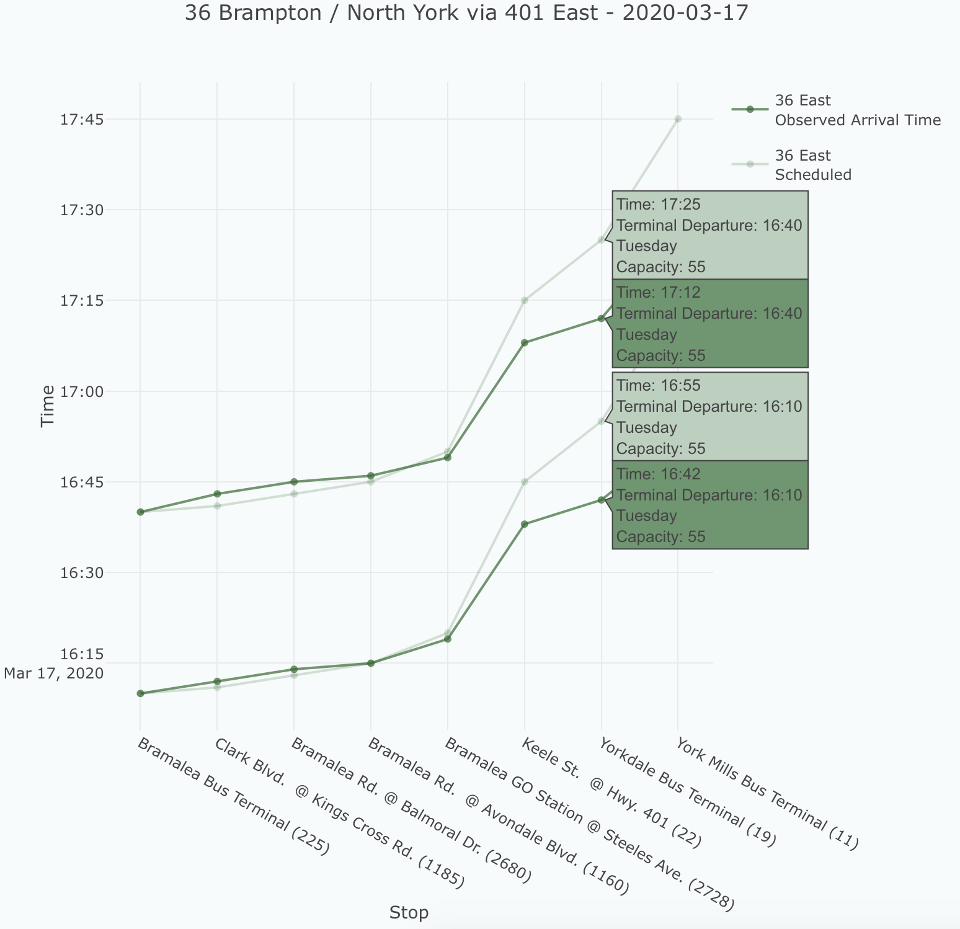
TRANSIFY APPLICATION - Enhanced analysis of route usage and performance
Identified trips that were much faster than before.
Could find efficiencies by adjusting runtimes in response to rapidly changing traffic patterns.
Track not just ridership, but highway congestion as well.
GO Bus schedules are individually scheduled for each trip based on its observed travel time.
Prototype for Illustration Only – Data are not official record

Slide 15
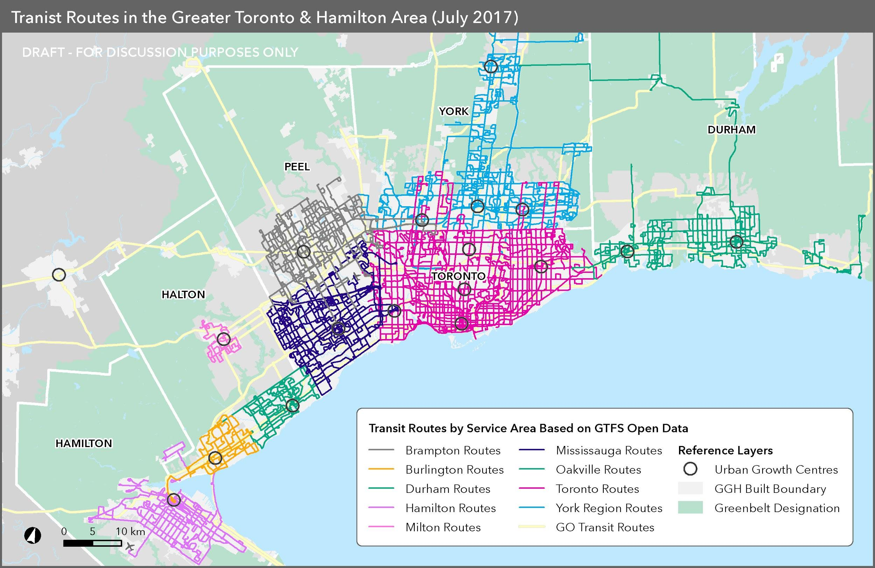
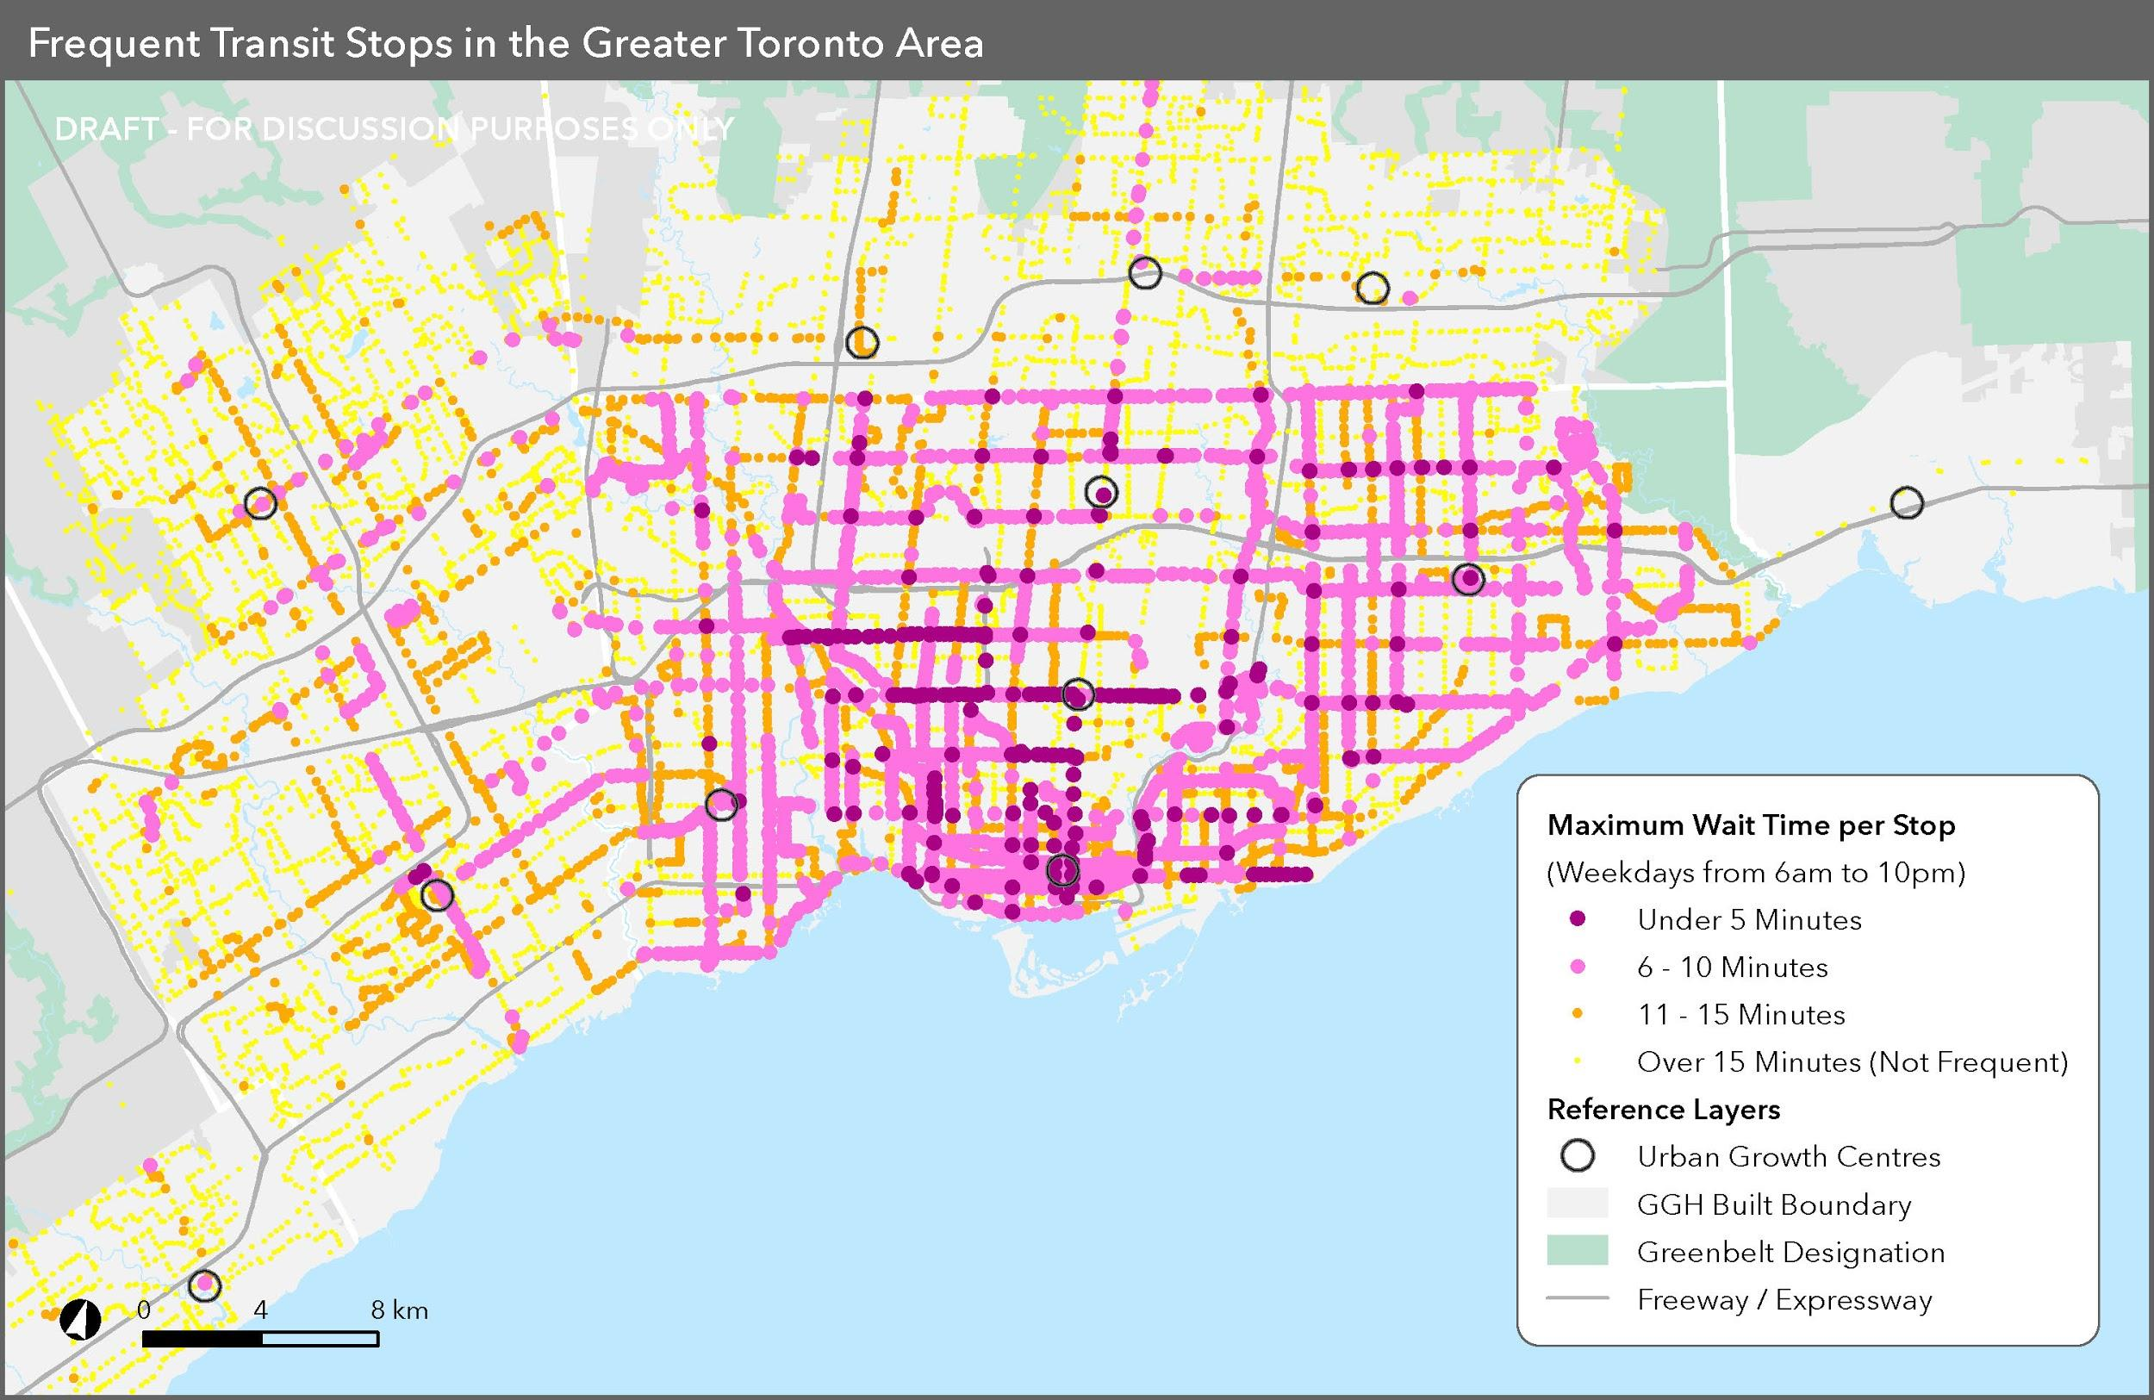
GTFS Data Analysis – Linking Multiple Datasets To Evaluate Service Frequency
Prototype for Illustration Only – Data are not official record

Slide 16
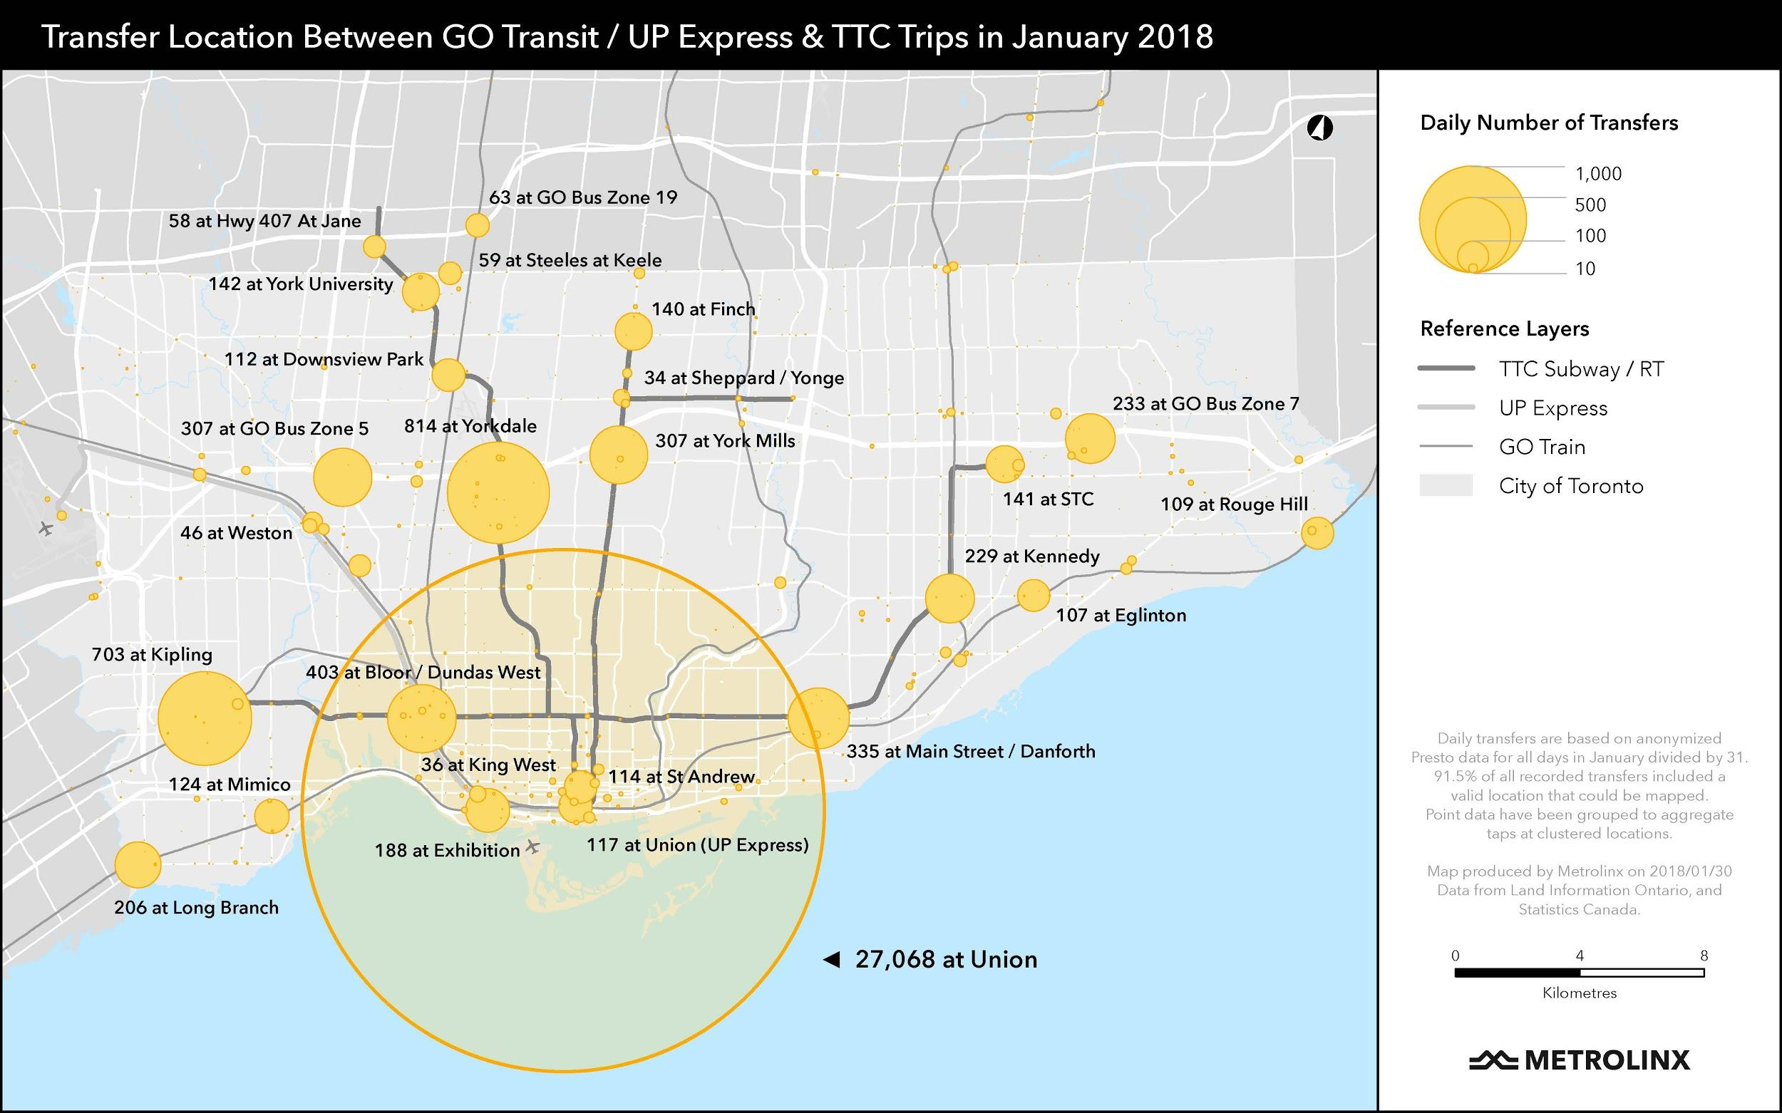
Presto Data Analysis – Mapping Locations where customers transfer from GO to TTC
Prototype for Illustration Only – Data are not official record

